Slide 1
Simulation Tools for Scaled Vehicle Courses
AuE-8360 Scaled Autonomous Vehicles
Chinmay Samak
PhD Candidate, CU-ICAR
csamak@clemson.edu
Tanmay Samak
PhD Candidate, CU-ICAR
tsamak@clemson.edu

Slide 2
List of Simulation Tools for Scaled Vehicle Courses
TurtleSim
Official F1TENTH Simulator (Rviz)
Driving Scenario Designer
Gazebo Simulator
F1TENTH Simulator (Gazebo)
CoppeliaSim (formerly V-REP)
F1TENTH Simulator (LGSVL)
Isaac Sim
AutoDRIVE Simulator
DRIVE Sim
CARLA Simulator
LGSVL Simulator
AirSim
AWSim
RaiSim
OpenAI Gym
Ansys Autonomy
CarMaker
CarSim
TORCS
Deepdrive
rFpro
dSPACE AURELION
PreScan
Webots
Cognata
Metamoto
VIRES VTD
GTA V
Project Chrono
Recommended for Courses/Training
Recommended for Research

Slide 3
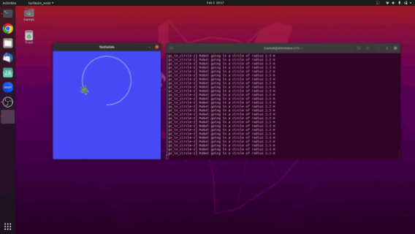
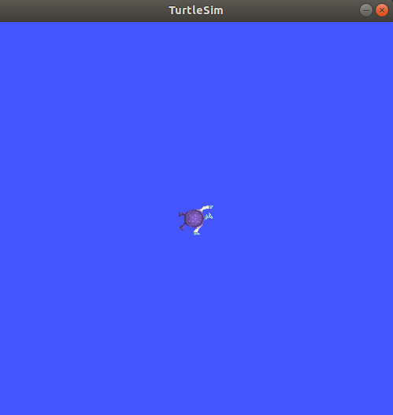
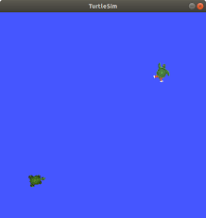

TurtleSim
Advantages
Open source
Simple & intuitive
Multi-robot support
Disadvantages
2D kinematic simulation
Environments not supported
Only differential-drive architecture
No cross-platform support
Source: Tinker Twins GitHub
Simulation Quality | Physics Engine | Graphics Rendering | Vehicle Dynamics Support | Sensor Support | API Support | Developer | Cost | Open Source | Applications
2D | Custom (kinematic simulation) | OpenGL | No | Pose | ROS, ROS 2 | Open Robotics | Free | Yes | Exploration and understanding
Source: ROS Core Stacks
Source: ROS Wiki

Slide 4
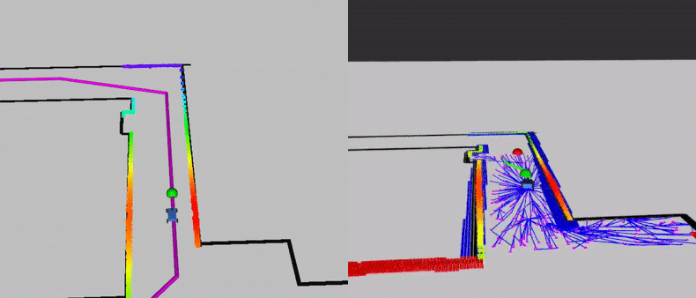
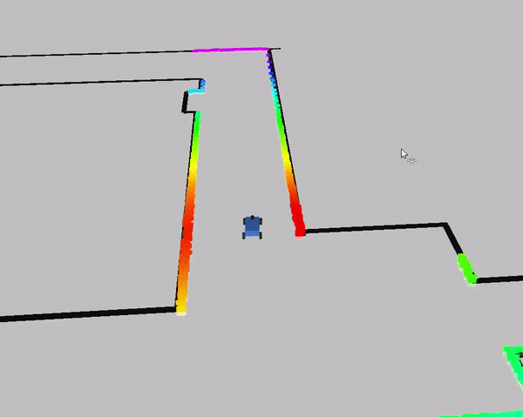

Official F1TENTH Simulator (RViz)
Advantages
Open source
Simple & intuitive
Uses same stack as real vehicle
Disadvantages
2D simplistic simulation
No vertical/roll/pitch dynamics
2D environment representation
No cross-platform support
Inaccuracies (e.g., 360° LIDAR simulation - real is 270°)
Simulation Quality | Physics Engine | Graphics Rendering | Vehicle Dynamics Support | Sensor Support | API Support | Developer | Cost | Open Source | Applications
2D | Custom (single track dynamics) | RViz | Single-track dynamics | 2D LIDAR | ROS, ROS 2, Autoware | UPenn | Free | Yes | Exploration, understanding, course, competition
Source: F1TENTH

Slide 5
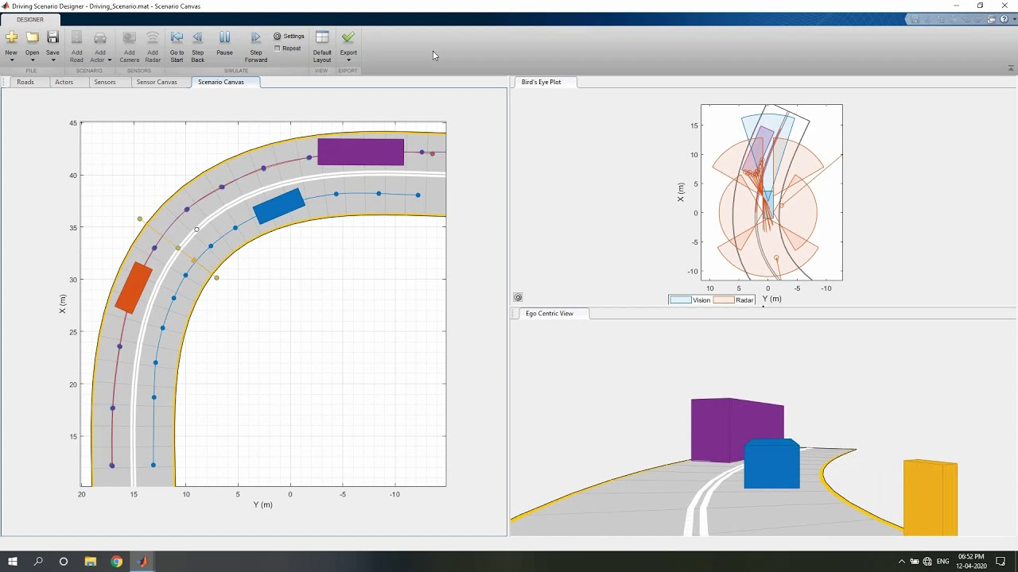
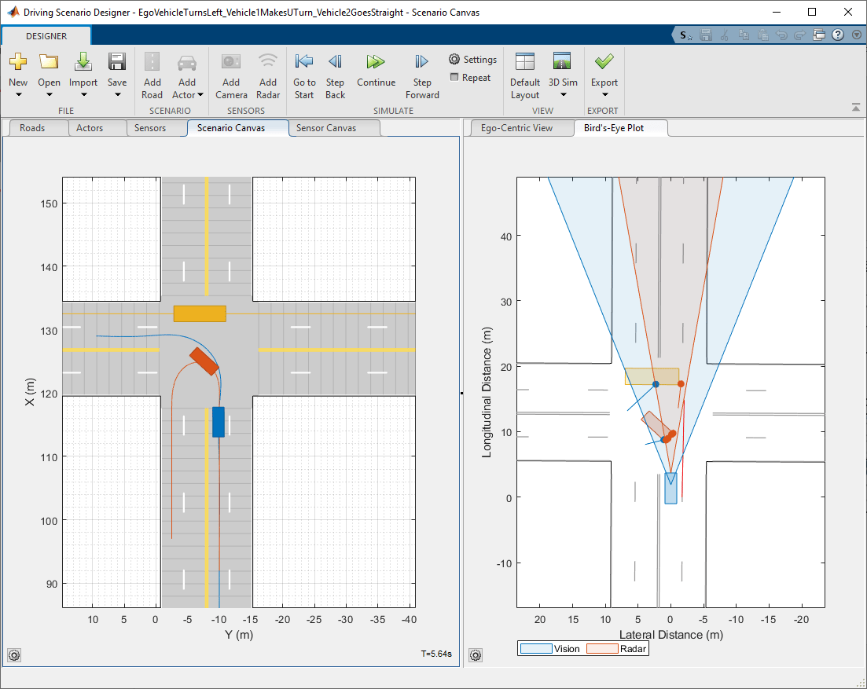
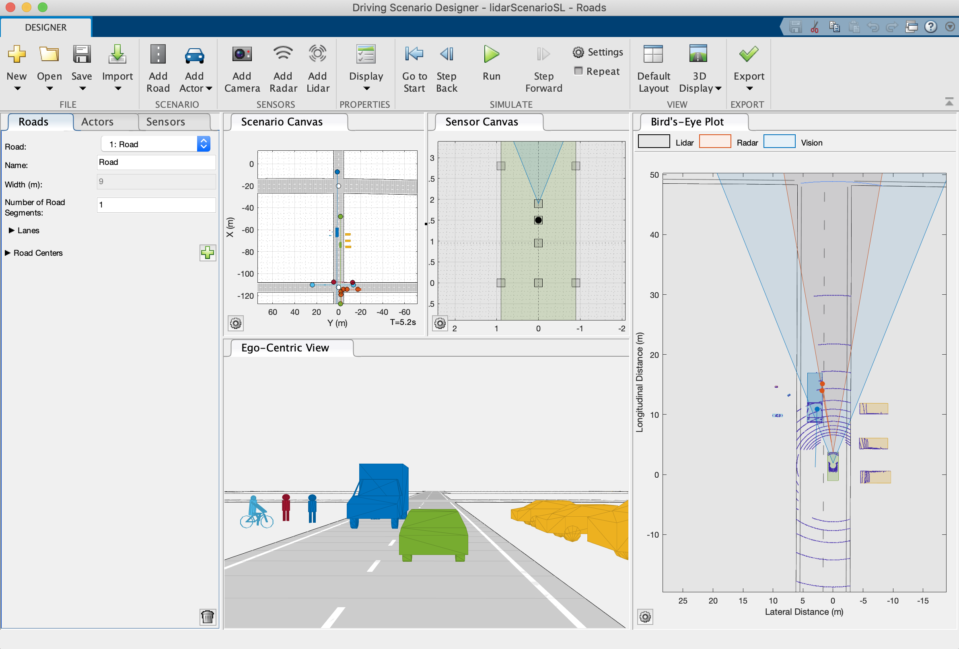

MathWorks Driving Scenario Designer
Advantages
Simple & intuitive
Multi-agent support
Comprehensive sensor suite
Disadvantages
Commercial product
2D/3D simplistic visualization
Simplistic trajectory replay
Simulation Quality | Physics Engine | Graphics Rendering | Vehicle Dynamics Support | Sensor Support | API Support | Developer | Cost | Open Source | Applications
2D/3D | N/A | MATLAB App | No | Camera, RADAR, LIDAR, INS, Ultrasonic | MATLAB, Simulink | MathWorks | Paid License | No | Exploration and understanding
Source: MathWorks

Slide 6
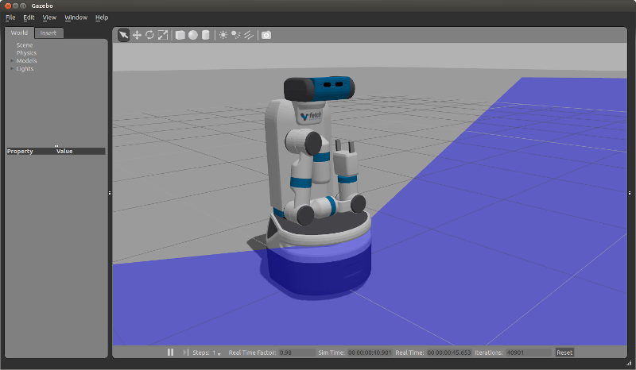
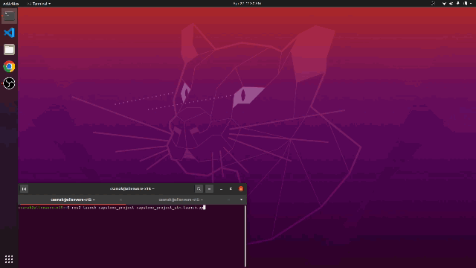
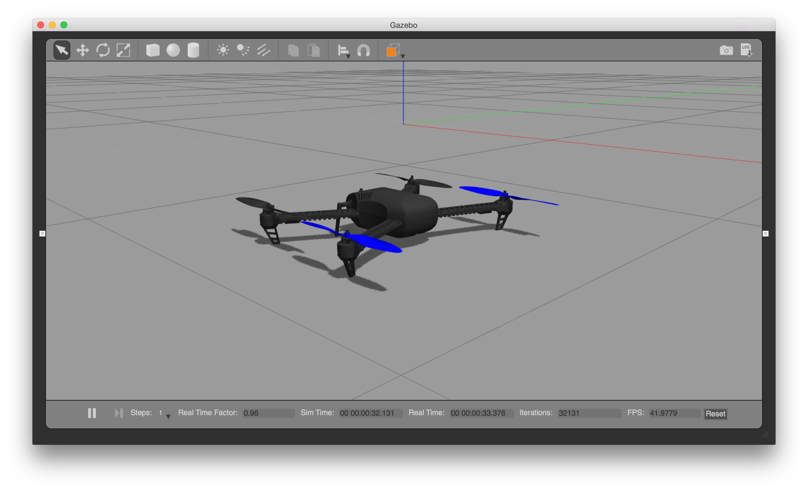

Gazebo Simulator
Advantages
Open source
Multi-agent support
Comprehensive sensor suite
General robotics simulation
Disadvantages
Low fidelity dynamics
Simplistic visualization
No cross-platform support
Source: Tinker Twins GitHub
Simulation Quality | Physics Engine | Graphics Rendering | Vehicle Dynamics Support | Sensor Support | API Support | Developer | Cost | Open Source | Applications
3D | ODE | Custom | Yes | Pose, Joint States, Camera, LIDAR, IMU, GPS | ROS, ROS 2 | Open Robotics | Free | Yes | Exploration and prototyping
Source: GazeboSim

Slide 7
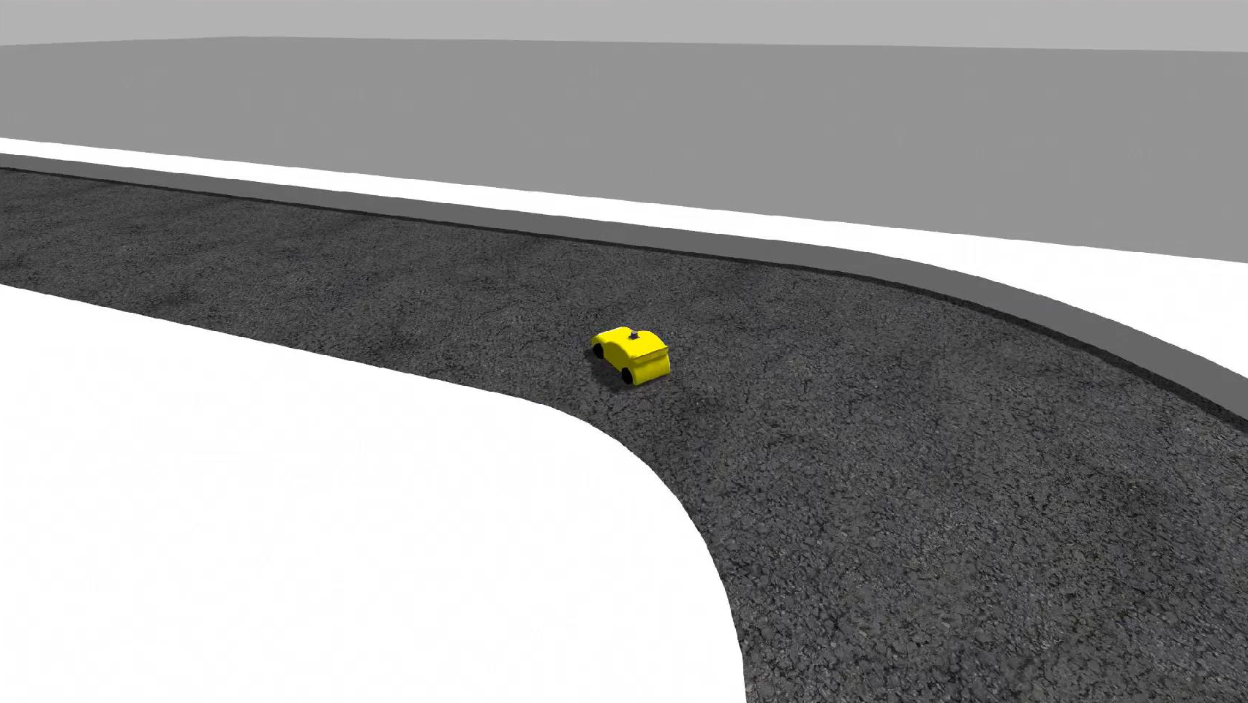
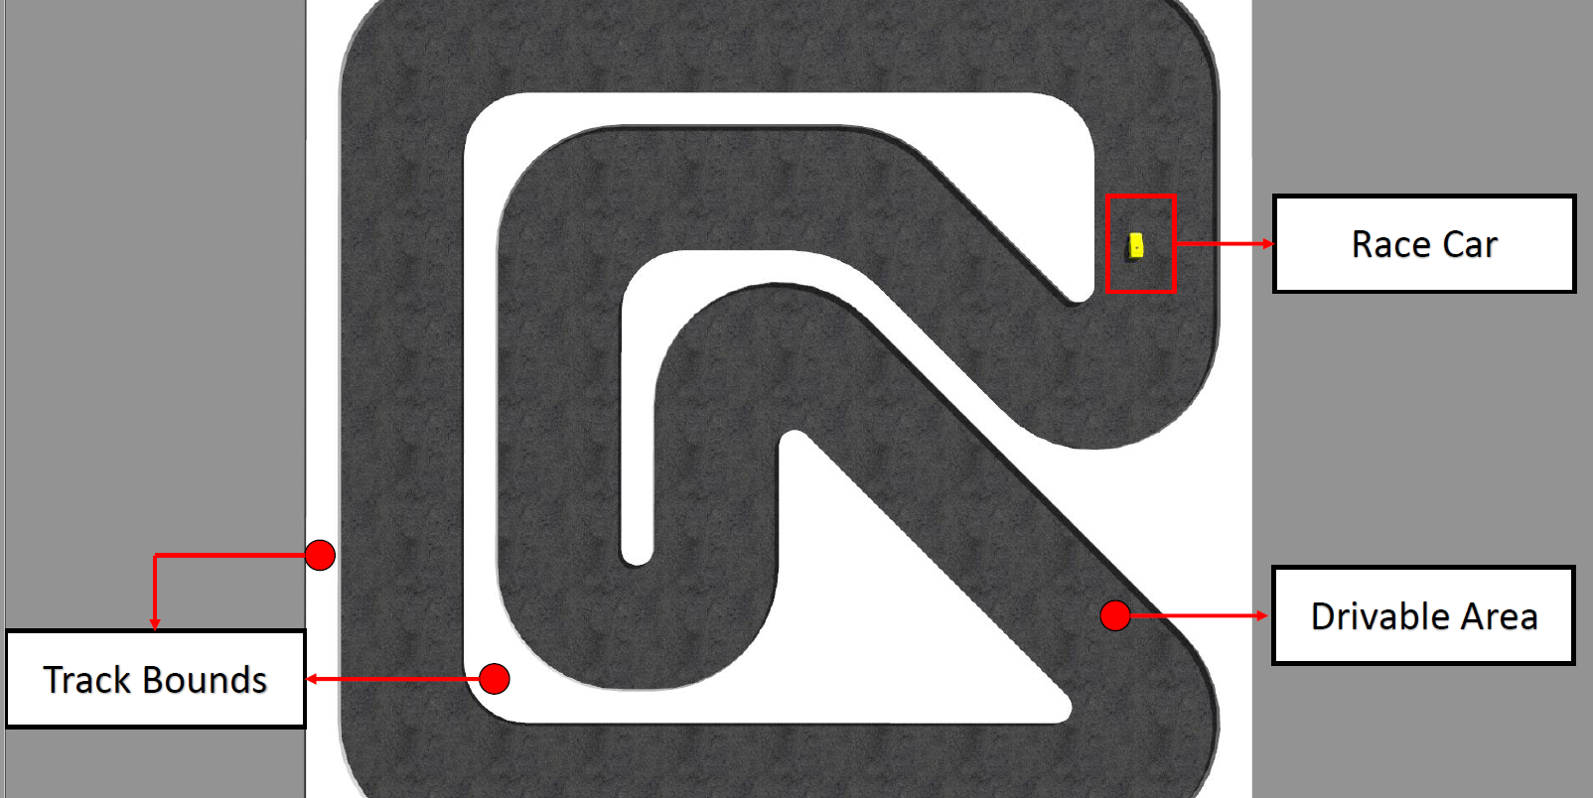

F1TENTH Simulator (Gazebo)
Advantages
Open source
Multi-agent support
Uses same stack as real vehicle
3D simulation environment
Disadvantages
Low fidelity dynamics
Simplistic visualization
No cross-platform support
Simulation Quality | Physics Engine | Graphics Rendering | Vehicle Dynamics Support | Sensor Support | API Support | Developer | Cost | Open Source | Applications
3D | ODE | Gazebo’s Custom | Yes | 2D LIDAR, Pose TF | ROS | UVA | Free | Yes | Exploration, prototyping, course
Source: f1tenth.dev

Slide 8
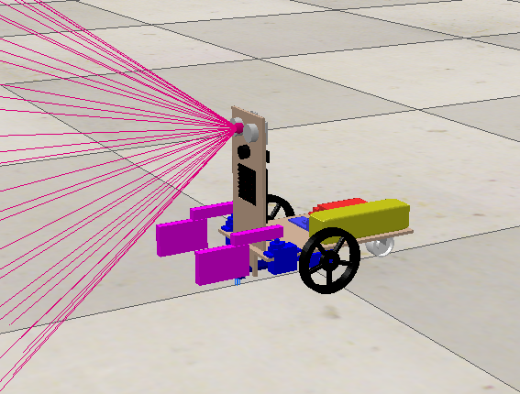
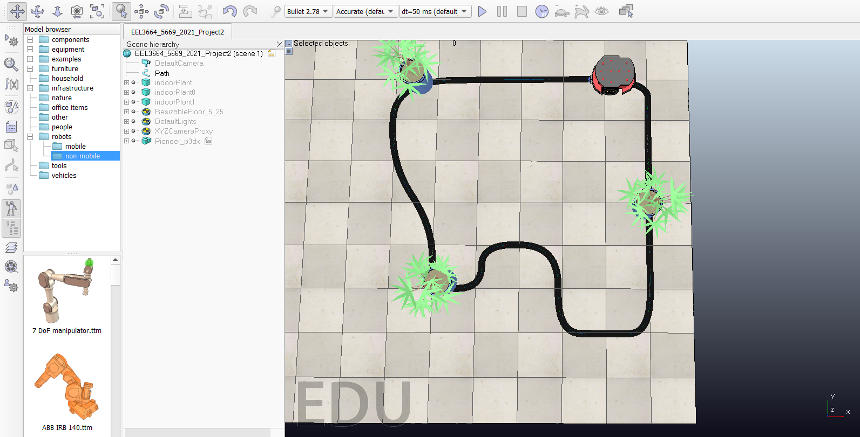
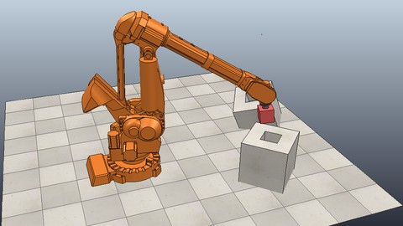

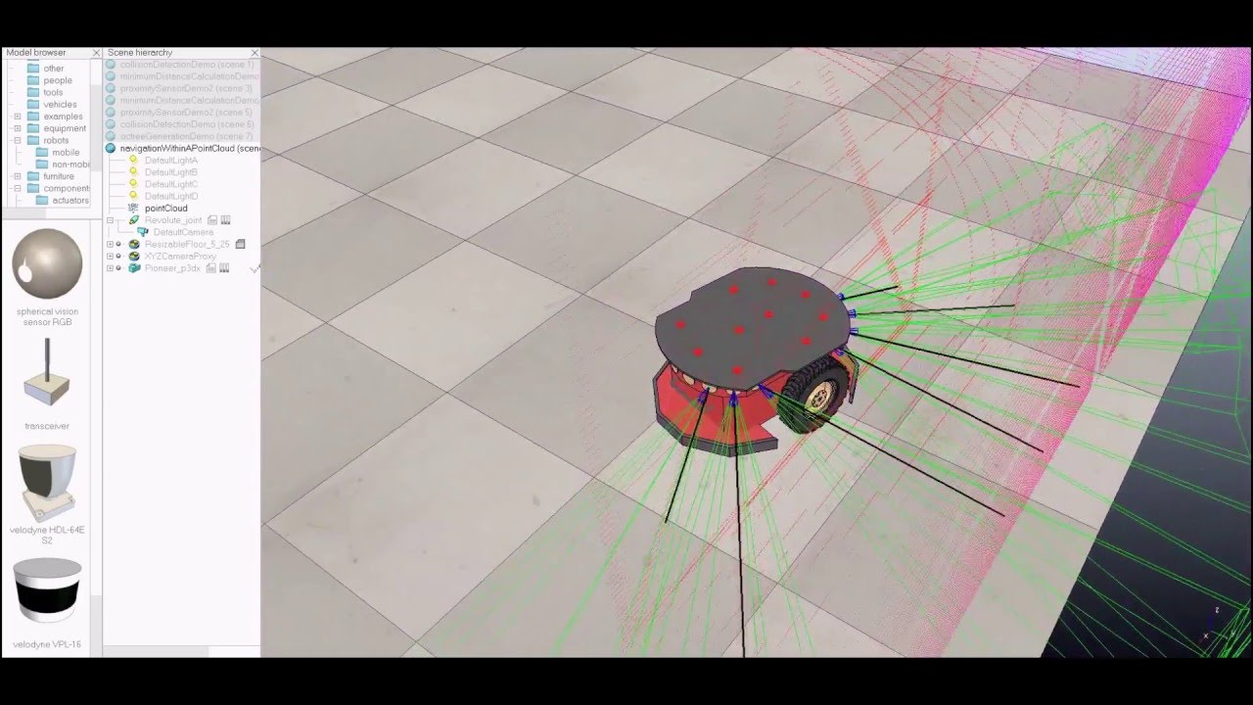
CoppeliaSim (formerly V-REP)
Advantages
3D simulation environment
Multiple physics engines
Cross-platform support
Extended API support
General robot simulator
Disadvantages
Moderate compute requirements
Medium fidelity graphics
Source: Coppelia Robotics
Simulation Quality | Physics Engine | Graphics Rendering | Vehicle Dynamics Support | Sensor Support | API Support | Developer | Cost | Open Source | Applications
3D | PhysX, Bullet, Vortex | Custom | Multi-body physics modules can be adapted for vehicle dynamics | 2D/3D LIDAR, Camera, GNSS, IMU, Encoders, State Variables | ROS, ROS 2, Python, C++ MATLAB | Coppelia Robotics | Free (Edu) | No | Exploration and education

Slide 9
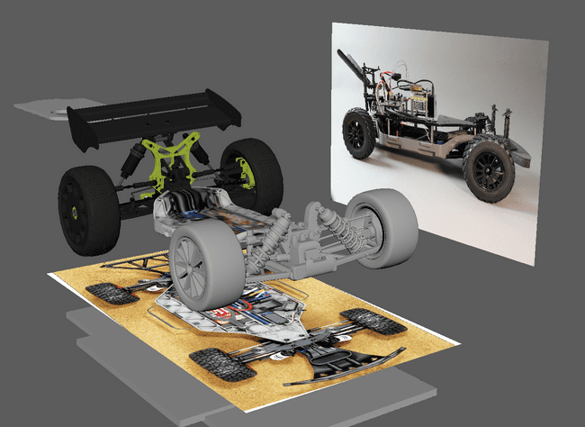
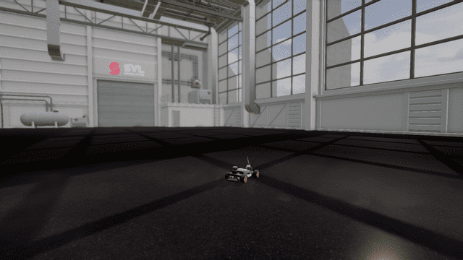
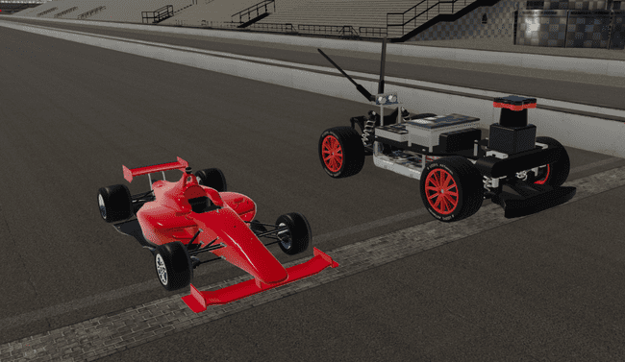

F1TENTH Simulator (LGSVL)
Advantages
3D simulation environment
Photorealistic graphics
Cross-platform support
Disadvantages
Inaccurate parameters
Heavy compute requirements
Discontinued
Simulation Quality | Physics Engine | Graphics Rendering | Vehicle Dynamics Support | Sensor Support | API Support | Developer | Cost | Open Source | Applications
3D | PhysX | Unity HDRP | Wheel torque model | 2D LIDAR, Camera | ROS | LG | Free/Paid | Yes | Exploration and research
Source: SVLSimulator

Slide 10
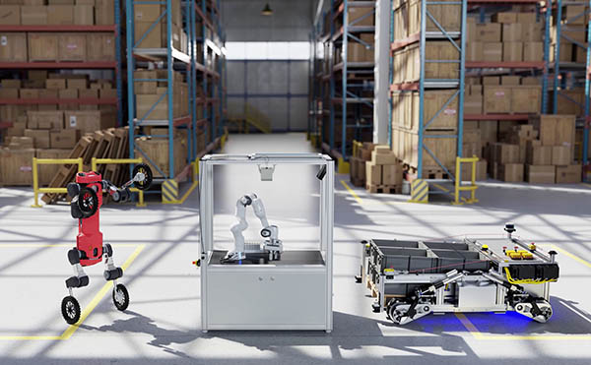
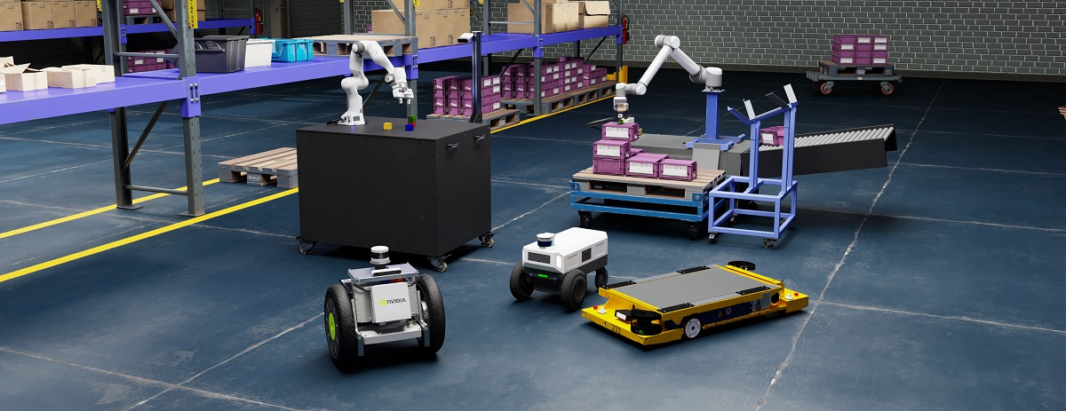
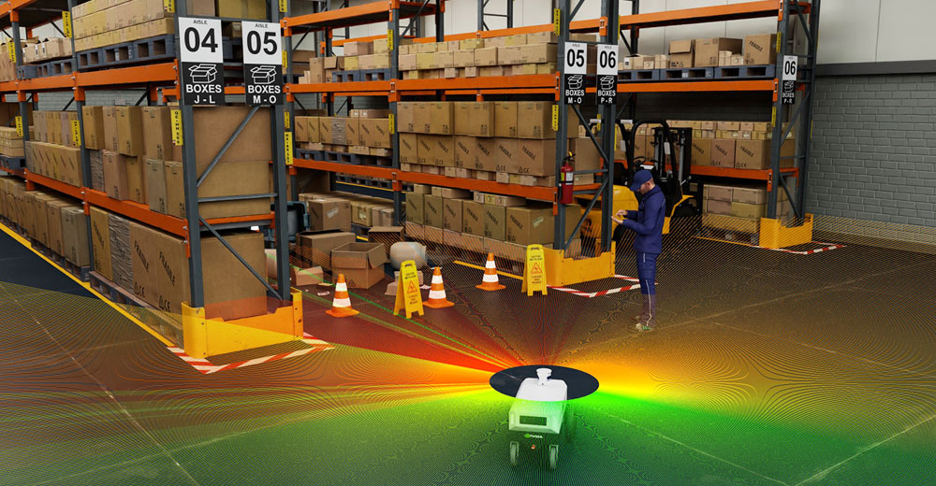
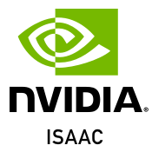

Isaac Sim
Advantages
3D simulation environment
Photorealistic graphics
Realistic physics
Cross-platform support
Indoor robot simulator
Disadvantages
Extreme compute requirements
Only NVIDIA RTX supported
Source: Isaac Sim
Simulation Quality | Physics Engine | Graphics Rendering | Vehicle Dynamics Support | Sensor Support | API Support | Developer | Cost | Open Source | Applications
3D | PhysX | Omniverse | Multi-body physics modules can be adapted for vehicle dynamics | 2D/3D LIDAR, Camera, GNSS, IMU, Encoders, State Variables | Python, ROS 2* | NVIDIA | Free | No | Exploration, education and research

Slide 11
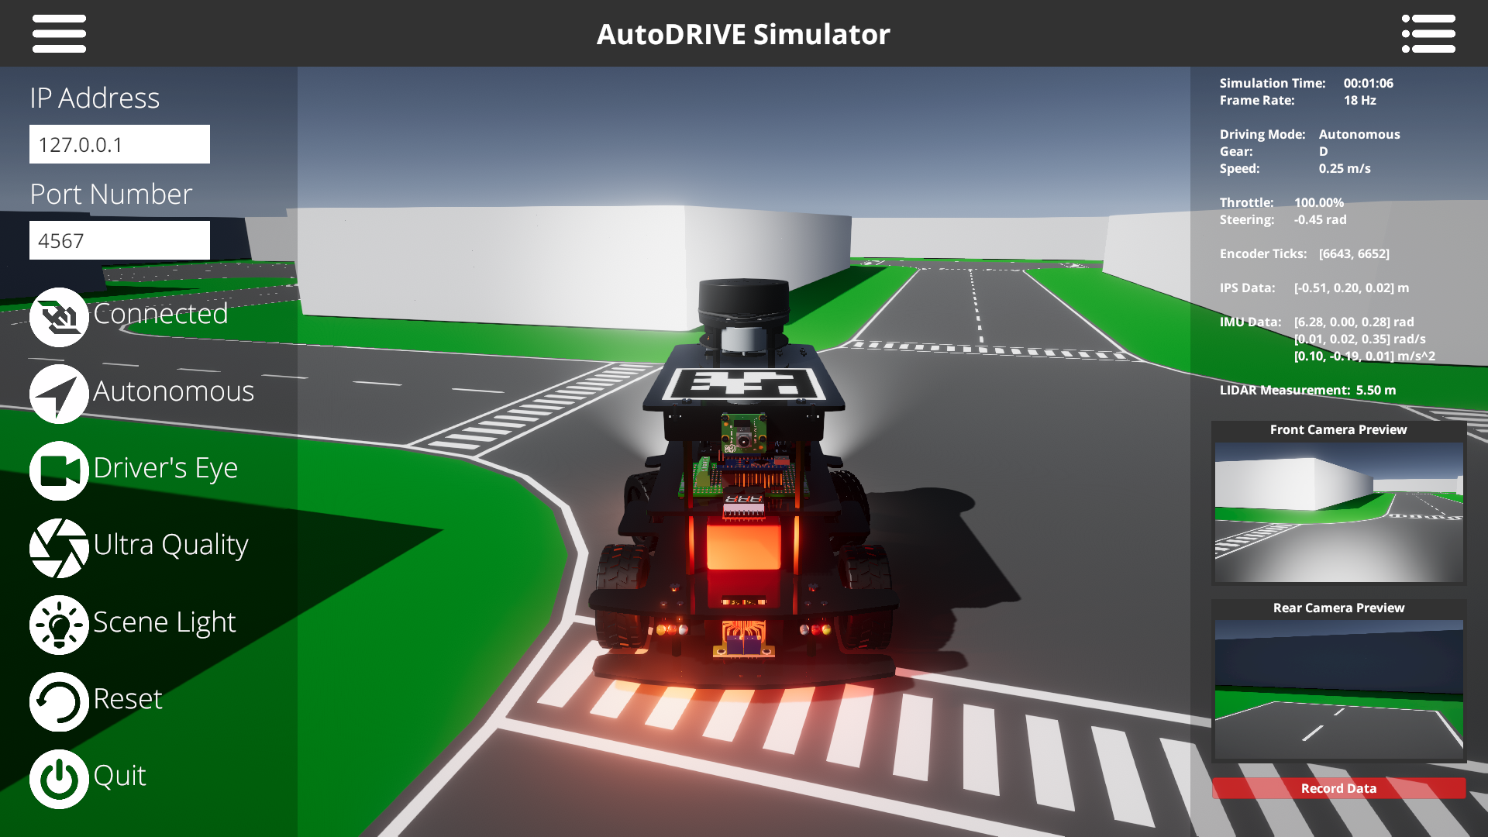
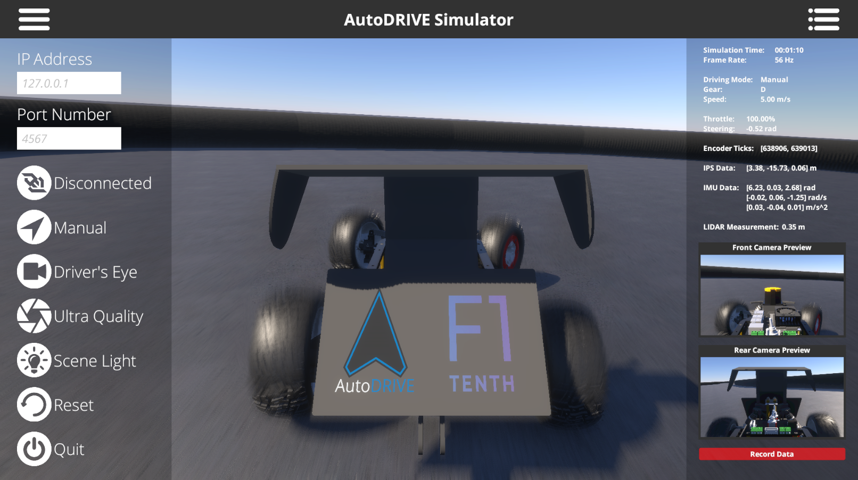

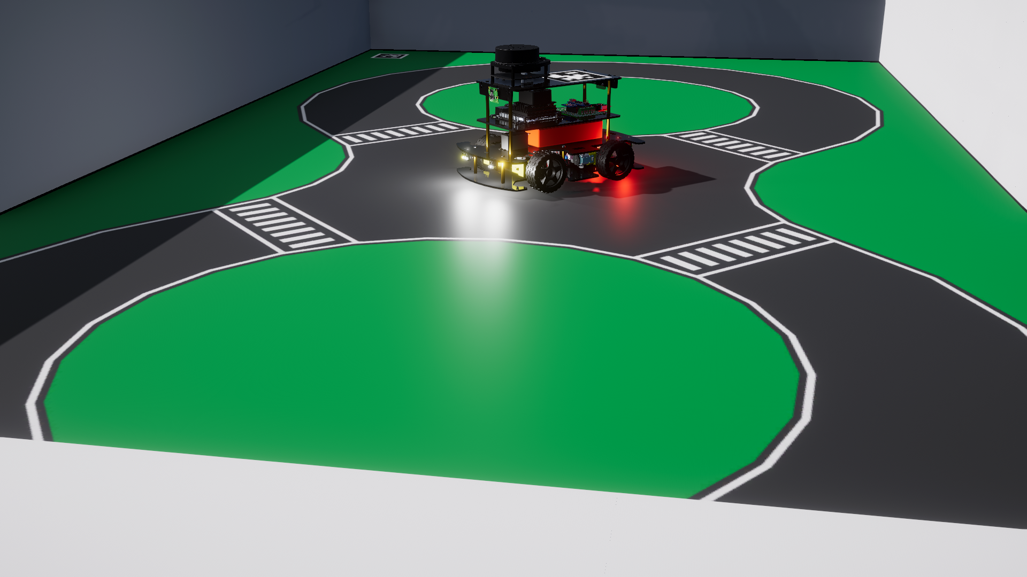
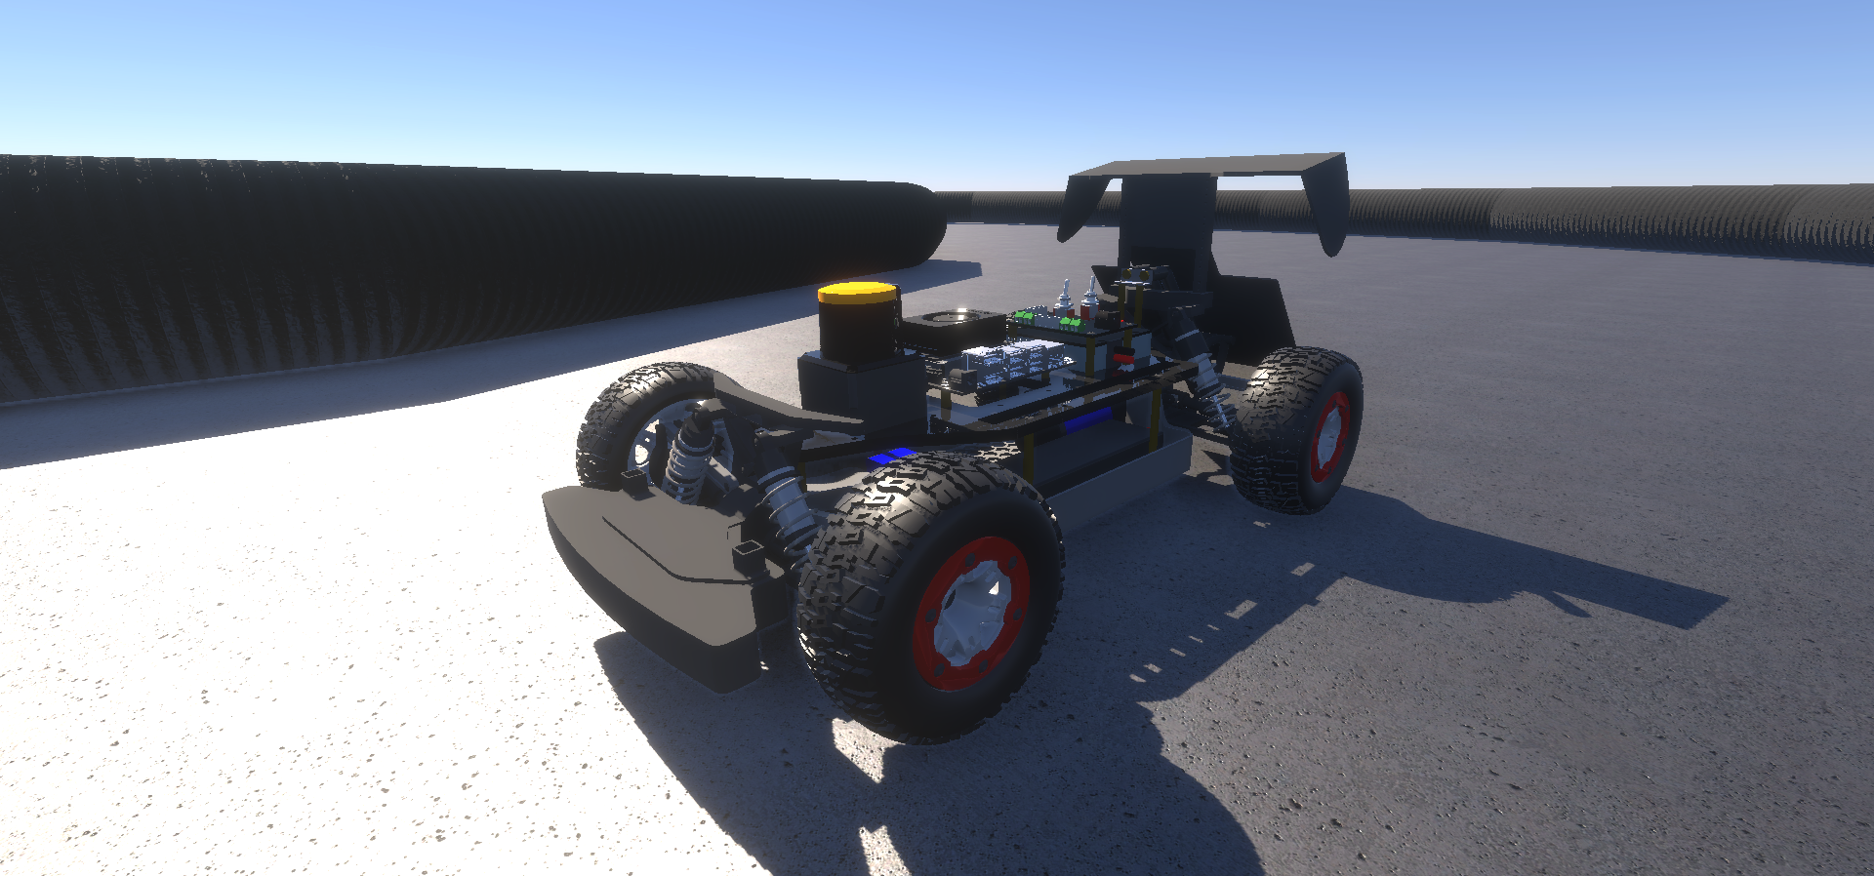
AutoDRIVE Simulator
Advantages
3D simulation environment
Photorealistic graphics
Realistic physics
Cross-platform support
Extended API support
On/off road AVs across scales
Disadvantages
Moderate compute requirements
Source: AutoDRIVE Ecosystem
Simulation Quality | Physics Engine | Graphics Rendering | Vehicle Dynamics Support | Sensor Support | API Support | Developer | Cost | Open Source | Applications
3D | PhysX | Unity HDRP | Full car model for lateral, longitudinal, vertical and RPY dynamics with tire-terrain interaction | 2D/3D LIDAR, Camera, GNSS, IPS, IMU, Encoders Steering Feedback, Throttle Feedback, State Variables | ROS, ROS 2, Python, C++, MATLAB, Simulink, Webapp | CU-ICAR, NTU, SRMIST | Free | Yes | Exploration, education and research

Slide 12
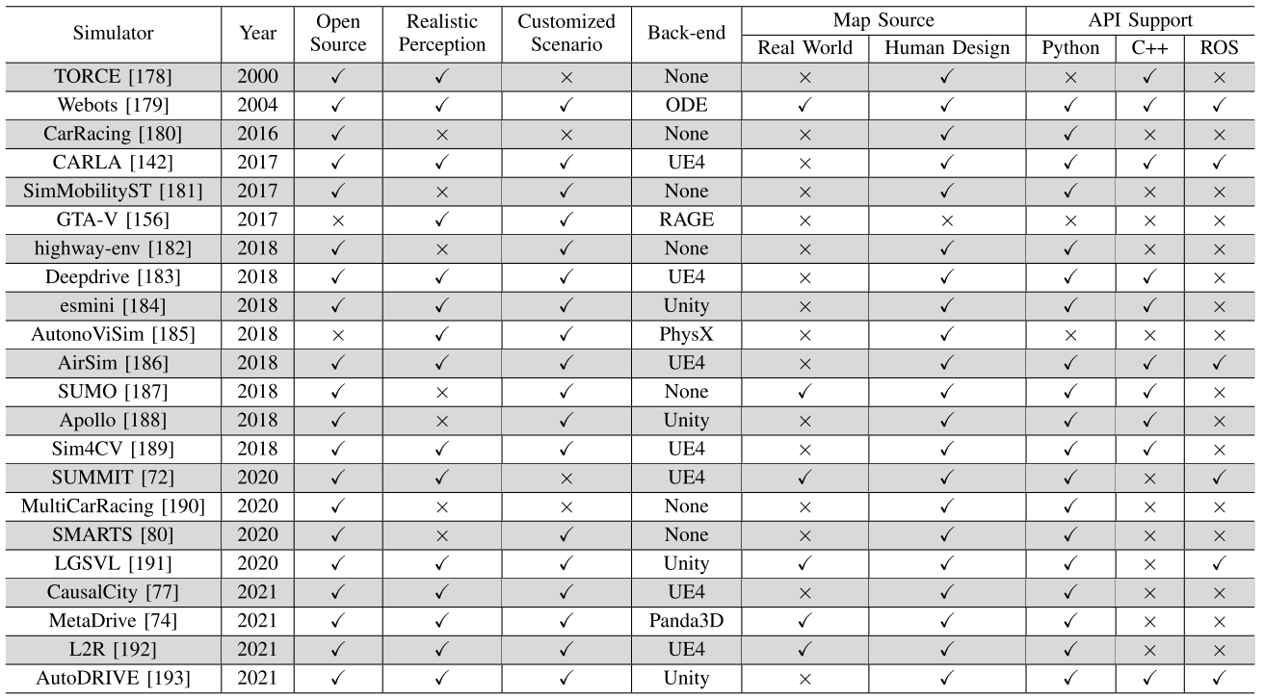
Comparative Analysis

Slide 13
References
M. Quigley, K. Conley, B. Gerkey, J. Faust, T. Foote, J. Leibs, R. Wheeler, and A. Ng, “ROS: an open-source Robot Operating System,” in ICRA 2009 Workshop on Open Source Software, vol. 3, Jan 2009. [Online]. Available: http://robotics.stanford.edu/~ang/papers/icraoss09-ROS.pdf
S. Macenski, T. Foote, B. Gerkey, C. Lalancette, and W. Woodall, “Robot operating system 2: Design, architecture, and uses in the wild,” Science Robotics, vol. 7, no. 66, p. eabm6074, 2022. [Online]. Available: https://www.science.org/doi/abs/10.1126/scirobotics.abm6074
V. S. Babu and M. Behl, “f1tenth.dev - An Open-source ROS based F1/10 Autonomous Racing Simulator,” 2020 IEEE 16th International Conference on Automation Science and Engineering (CASE), Hong Kong, China, 2020, pp. 1614-1620, doi: 10.1109/CASE48305.2020.9216949
M. O'Kelly, H. Zheng, D. Karthik and R. Mangharam, “F1TENTH: An Open-source Evaluation Environment for Continuous Control and Reinforcement Learning,” Proceedings of Machine Learning Research, H.J. Escalante R. Hadsell (eds.), Proceedings of the NeurIPS 2019 Competition and Demonstration Track, PMLR, vol. 123, pp. 77-89, December 2020. [Online]. Available: https://proceedings.mlr.press/v123/o-kelly20a.html

Slide 14
References
N. Koenig and A. Howard, “Design and use paradigms for Gazebo, an open-source multi-robot simulator,” 2004 IEEE/RSJ International Conference on Intelligent Robots and Systems (IROS) (IEEE Cat. No.04CH37566), Sendai, Japan, 2004, pp. 2149-2154 vol.3, doi: 10.1109/IROS.2004.1389727
E. Rohmer, S. P. N. Singh and M. Freese, “V-REP: A versatile and scalable robot simulation framework,” 2013 IEEE/RSJ International Conference on Intelligent Robots and Systems, Tokyo, Japan, 2013, pp. 1321-1326, doi: 10.1109/IROS.2013.6696520
G. Rong et al., “LGSVL Simulator: A High Fidelity Simulator for Autonomous Driving,” 2020 IEEE 23rd International Conference on Intelligent Transportation Systems (ITSC), Rhodes, Greece, 2020, pp. 1-6, doi: 10.1109/ITSC45102.2020.9294422
T. Samak, C. Samak, S. Kandhasamy, V. Krovi, and M. Xie, “AutoDRIVE: A Comprehensive, Flexible and Integrated Digital Twin Ecosystem for Autonomous Driving Research & Education,” Robotics, vol. 12, no. 3, p. 77, May 2023, doi: https://doi.org/10.3390/robotics12030077

Slide 15
References
W. Ding, C. Xu, M. Arief, H. Lin, B. Li and D. Zhao, “A Survey on Safety-Critical Driving Scenario Generation—A Methodological Perspective,” in IEEE Transactions on Intelligent Transportation Systems, vol. 24, no. 7, pp. 6971-6988, July 2023, doi: 10.1109/TITS.2023.3259322

